Slide 1

SPINE X-RAY-BASED OSTEOPOROSIS DETECTION USING DEEP LEARNING TECHNIQUES
Department of Information Technology
Under the Supervision of
Dr. R. SUDHA KISHORE M.Tech, Ph.D
PRESENTED BY:
M. Sumalatha - 21BQ1A1281
M. Jyothi - 22BQ5A1213
K. Padmanjali - 21BQ1A1272

Slide 2
Contents
Abstract
Introduction with motivation
Existing System with references
Proposed System with advantages
Software Requirements
Hardware Requirements
Functional Requirements
Non Functional Requirements
System Architecture
System Design
Output Screens
System Modules
Conclusion
Future Scope
2

Slide 3
ABSTRACT
Bone fractures are common in elderly patients due to osteoporosis, a prevalent metabolic bone disease in this population. While early diagnosis is possible, current techniques (such as DEXA, QCT, etc.) are often expensive and invasive. This project proposes a less complex deep learning model to predict osteoporosis using grayscale images of human spine X-rays. The VGG16 CNN architecture is applied for feature extraction, and the extracted features are classified using a Feedforward Neural Network (FNN). The database for this project was obtained from publicly accessible archives. The results demonstrate high accuracy, supporting the effectiveness of the proposed model that integrates VGG16 with FNN for an automatic osteoporosis diagnostic system. Specifically, this imaging-based approach offers an alternative for early diagnosis at lower costs and with less invasiveness, ultimately improving diagnostic effectiveness and enhancing patient care.
3

Slide 4
INTRODUCTION
Osteoporosis increases fracture risk, especially in the elderly, and current diagnostic methods (DEXA, QCT) are expensive and/or invasive.
This project uses deep learning on grayscale spine X-ray images to predict osteoporosis, offering a less complex, cost-effective, and non-invasive alternative.
The model employs VGG16 for feature extraction from X-rays and an FNN for classification and prediction.
A publicly available dataset is used for training and evaluation, ensuring transparency.
High accuracy results suggest the VGG16-FNN model's potential as an automated osteoporosis diagnostic tool, improving early detection and patient care.
4

Slide 5
EXISTING SYSTEM
Current osteoporosis detection techniques include:
DEXA (Dual-Energy X-ray Absorptiometry): Gold standard, but costly and requires specialized equipment.
QCT (Quantitative Computed Tomography): Provides precise bone density measurements but involves radiation exposure.
Machine Learning-Based Approaches: Explored in recent studies, but often require complex feature engineering.
DISADVANTAGES OF EXISTING SYSTEM:
High Cost & Limited Accessibility: Traditional methods like DEXA and QCT are expensive, require specialized equipment, and are not widely available in low-resource settings.
Invasiveness & Human Error: QCT exposes patients to radiation, making frequent monitoring difficult, while manual interpretation of results can lead to inconsistencies.
5

Slide 6
PROPOSED SYSTEM
This project proposes an automated, non-invasive, and cost-effective osteoporosis detection system using spine X-ray images. By leveraging VGG16 for feature extraction and FNN for classification, it ensures high accuracy, reduces human error, and speeds up diagnosis. The system is scalable, suitable for resource-limited settings, and can be integrated into hospital systems for real-time analysis. Ultimately, it enhances early detection, efficiency, and patient outcomes while minimizing reliance on expensive imaging techniques.
6

Slide 7
PROPOSED SYSTEM ADVANTAGES
This project proposes an automated osteoporosis detection system using deep learning techniques. The key advantages include:
Non-Invasive: Uses X-ray images instead of specialized scans.
Cost-Effective: Reduces dependency on expensive imaging techniques.
Automated Diagnosis: Reduces human error and enhances efficiency.
High Accuracy: Utilizes VGG16 for robust feature extraction and FNN for classification.
7

Slide 8
SOFTWARE REQUIREMENTS
Visual Studio Code
Programming Language: Python
Languages for Front-end: HTML, CSS, JS
Libraries: TensorFlow, Keras, OpenCV, NumPy, Pandas
Framework: Flask (for web deployment)

Slide 9
HARDWARE REQUIREMENTS
Operating System : Windows
Processor: Intel CORE i5 or above
RAM: 8GB (16GB recommended for training models)
GPU: NVIDIA GTX 1050 or higher (for deep learning model training)
Storage: 25GB free space (for datasets and models)

Slide 10

FUNCTIONAL & NON-FUNCTIONAL REQUIREMENTS
FUNCTIONAL REQUIREMENTS
Image Processing: Accepts and preprocesses X-ray images, then uses VGG16 CNN for feature extraction.
Classification & Output: Employs FNN for osteoporosis prediction, providing a clear result.
Data Handling: Handles and stores images, results, and optional anonymized patient data with confidence levels.
NON-FUNCTIONAL REQUIREMENTS
Scalability: Supports increasing dataset sizes.
Performance: Provides fast and accurate predictions.
Security: Ensures data privacy and protection.
Usability: Offers an easy-to-use interface for doctors.

Slide 11

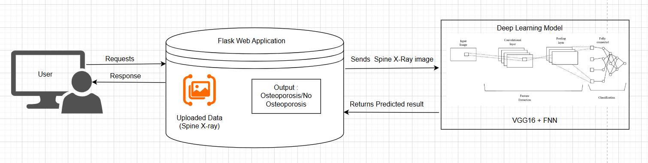
SYSTEM ARCHITECTURE

Slide 12
UML DIAGRAMS

Slide 13
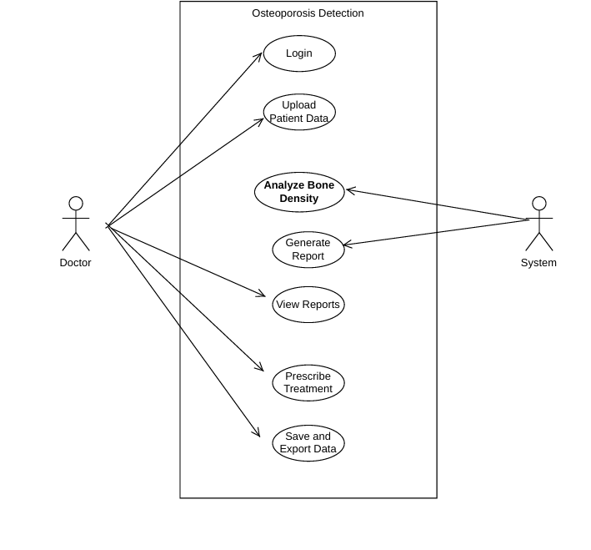
USE CASE DIAGRAM:

Slide 14
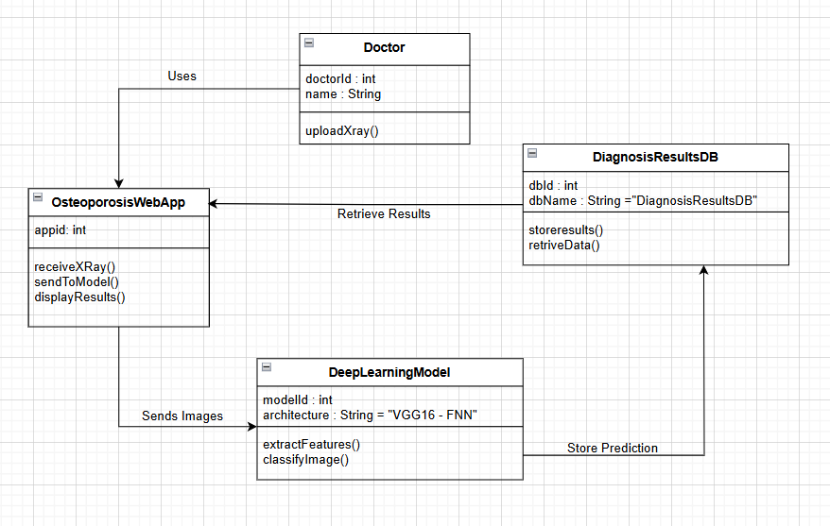
CLASS DIAGRAM :

Slide 15
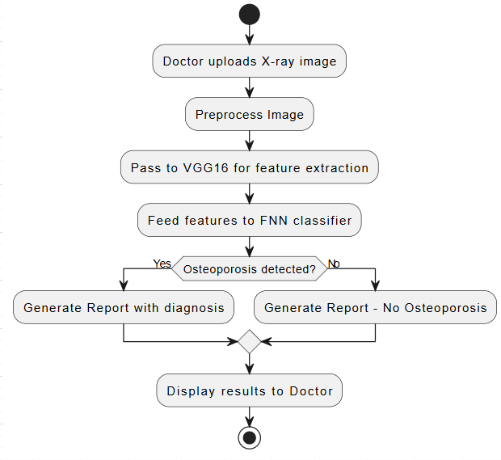
ACTIVITY DIAGRAM:

Slide 16
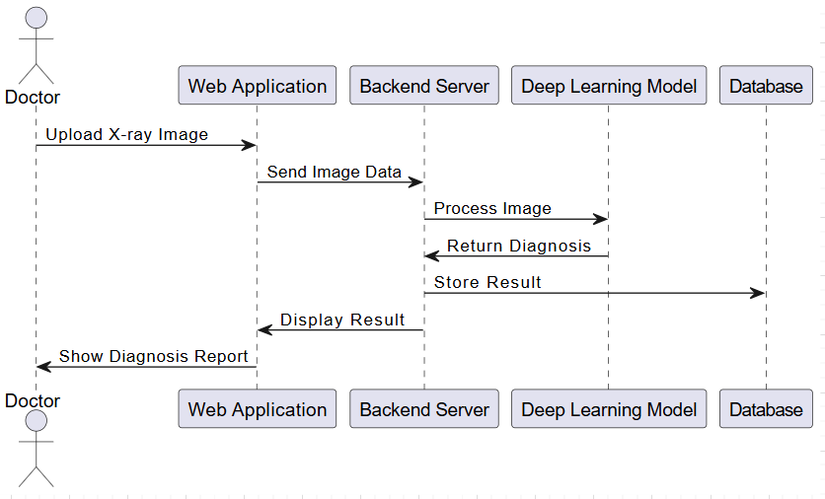
SEQUENCE DIAGRAM:

Slide 17
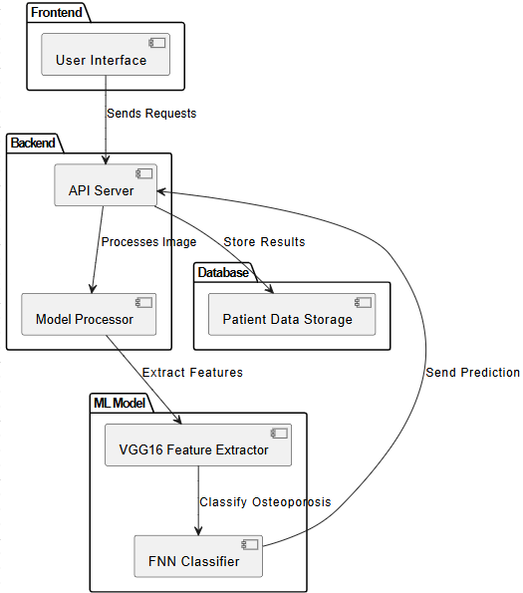
COMPONENT DIAGRAM:

Slide 18
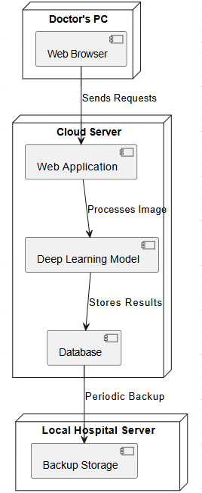
DEPLOYMENT DIAGRAM:

Slide 19
MODULES
Image Preprocessing Module: This module handles the preprocessing of spine X-ray images. It includes steps such as resizing, normalization, and noise reduction to enhance image quality. Techniques like histogram equalization and contrast adjustment are applied to ensure consistency across different images.
Feature Extraction Module (VGG16):Utilizes the VGG16 deep learning model to extract high-level features from X-ray images. Converts raw image data into meaningful representations, reducing the need for manual feature engineering.

Slide 20
Classification Module (FNN): The extracted features are fed into a Feedforward Neural Network (FNN) for classification. The FNN determines whether the given X-ray image indicates osteoporosis or a normal bone condition. Uses activation functions and backpropagation to optimize prediction accuracy.
User Interface Module: Provides an intuitive interface for users (doctors or radiologists) to upload X-ray images and view results. Displays prediction outcomes and allows users to store and retrieve previous diagnosis records.

Slide 21
CONCLUSION
This project provides an efficient, cost-effective, and non-invasive method for osteoporosis detection using deep learning techniques. By leveraging VGG16 and FNN, it achieves high accuracy while minimizing diagnostic costs and complexity. This solution has the potential to significantly improve early osteoporosis detection, enhancing patient care and treatment outcomes.

Slide 22
FUTURE SCOPE
Improve accuracy by experimenting with other deep learning architectures.
Expand dataset to include diverse patient demographics.
Develop a web-based or mobile application for real-world implementation.
Integrate with hospital systems for automated screening in clinical settings.

Slide 23
REFERENCES
[1] Kanis, J. A., & Glüer, C. C. (2000). An update on the diagnosis and assessment of osteoporosis with densitometry. Osteoporosis International, 11(3), 192-202.
[2] Lewiecki, E. M. (2010). DXA: Clinical applications and new perspectives. Bone, 47(3), 455-465.
[3] Jha, S., et al. (2015). Artificial intelligence in osteoporosis detection: A review. Journal of Medical Imaging, 2(4), 041010.
[4] Litjens, G., et al. (2017). A survey on deep learning in medical image analysis. Medical Image Analysis, 42, 60-88.

Slide 24


